Slide 1
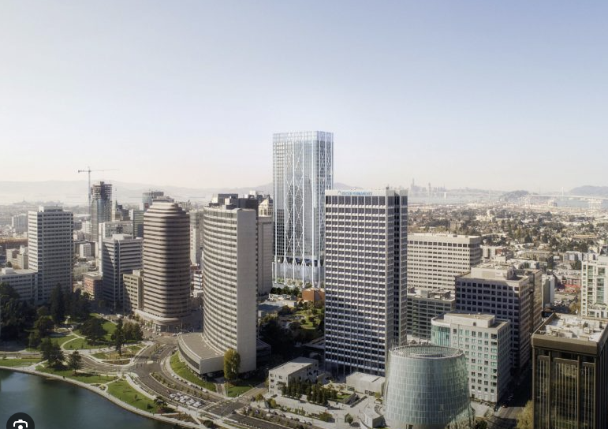
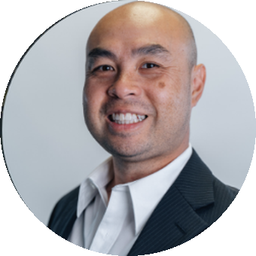
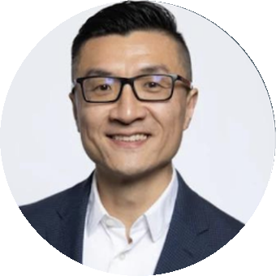

REAL ESTATE AI AGENT WORKSHOP
How to use AI to find more
deals and win more clients
QR TBD
scan to RSVP
2425 Valdez St., Oakland, CA 94612
July 20th, 2026
5:00–7:00 PM
Barton Louie
Quan Zou
SubTo • Company TBD
SubTo • Sequoia Real Estate
AI AGENT
BLUEPRINT
MONMAC
LABS
Notes:
Canva import notes: Upload this PPTX to Canva. Text boxes, QR squares, panels, venue box, speaker labels, footer labels, portraits, logo, and background are separate layers. Replace QR TBD with final RSVP QR. Barton company name remains TBD. Do not publish until David QA and Quan approval.

